Slide 1
Aims and Outcomes in QI: What’s Data got to Do With It?
Paul F. Cook, PhD
Associate Professor
university of Colorado College of Nursing

Slide 2
Less than 17 Years?
Historical Context: Prevention of Scurvy
1593 – Admiral Sir Richard Hawkins recommends oranges & lemons to prevent scurvy, based on Portuguese stories as far back as 1497
1601 – Capt. James Lancaster gives lemons as a prospective treatment to 1 ship which avoids scurvy, and no lemons to 3 other ships that develop it.
1747 – James Lind demonstrates cure of scurvy in a randomized trial!
1756-63 – over 130,000 sailors die of scurvy in the Seven Years’ War
1795 – case study: HMS Suffolk sails to India with lemon juice & no scurvy
By 1800 – scurvy is virtually eliminated in Royal Navy sailors (“limeys”)
1867 – Act of Parliament to also eliminate scurvy in the Merchant Navy
Time to get evidence into practice: 274 years
Evidence into Practice in 2019: It Only Takes 17 Years
About the time for a new “generation” of providers to come on board
Currently, health care improves primarily by attrition
Berwick, 2003, JAMA 289:1969-75
Notes:
Scurvy killed about 2 million sailors between 1500 and 1800
Formal solution in 1867 required lemons & limes under the Merchant Shipping Amendment Act

Slide 3
Can We Really End HIV by 2030? (That’s 11 Years)
Prevention efforts to eliminate new HIV infections
Reduce stigma so that people can talk about HIV
Prevention for at-risk communities (behavioral, pre-exposure prophylaxis [PrEP])
Increase effective treatment for people living with HIV (“undetectable = untransmittable,” or U=U)
The Care Continuum: Early and effective treatment for people living with HIV
Increased HIV testing to identify people early in the course of infection
Early linkage to care for treatment of HIV
Adherence to antiretroviral medications
Retention in care to maintain viral suppression
Treatment is also prevention (U = U)
https://www.hhs.gov/blog/2019/02/05/ending-the-hiv-epidemic-a-plan-for-america.html

Slide 4
How Can We Get There from Here?
“measurement is improvement” – Donald Berwick

Slide 5
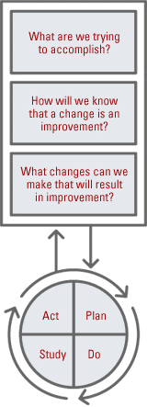
Quality Improvement: The IHI Model
1. Form an Interprofessional Team
2. Set an Aim-- The aim should be time-specific and measurable, stating exactly “How good?,” “By when?,” and “For whom?”
3. Establish Measures Outcome Measures = Where are we ultimately trying to go?
Process Measures = Are we doing the right things to get there?
Balancing Measures = Are the changes we are making to one part of the system causing problems in other parts of the system?
4. Identify Changes -- Often stem from a root cause analysis
5. Test Changes -- Here’s where the PDSA cycles come in
6. Implement Changes
7. Spread Changes
Institute for Healthcare Improvement (2015). How to Improve. Retrieved from http://www.ihi.org/resources/Pages/HowtoImprove/default.aspx
Notes:
Used already at Dakota site, both Colorado sites, maybe others.

Slide 6
Consider Including Patients on the Team
Something qualitatively different happens – an “aliveness of the human spirit” – when providers and patients become people working on a shared problem together
Frame I
Frame II
Frame III
Separate professions
Siloes of influence
Frame IV
Frame V
New providers learn “the way we do things here”
IP team care is the new normal: “the only way we know”
The experts haven’t seen any Level V environments yet!
“Don’t you people talk to each other?”
Awakening curiosity
Efforts for quality improvement
“How can we do this better?”
The shift to interprofessional teams
Trying something new, a foot in both worlds
Forming stable teams
Mutual respect and complementary work
Still fragile and at risk
Starting to see better outcomes
Feels like a different kind of place to work
The patient is now a key member of the IP team
Uhlig P & Raboin WE, 2015, Field Guide to Collaborative Care. Overland Park, KS: Oak Prairie Health Press.

Slide 7
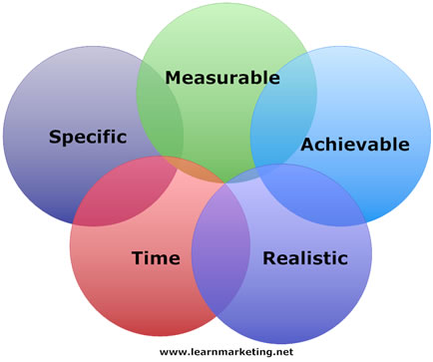
Steps in the IHI Model
1. Develop your AIM: (S.M.A.R.T. goal)
“Measurable” = based on data!
2. How will I know my change is an improvement?
Baseline data – where are you starting?
Goals – where do you want to be?
Benchmarks – where are others? who does it best?
3. Identify changes – this is not the starting point
4. PDSA Cycles to test the effects of changes
Process measures tell you what you are doing
Outcome measures match your AIM, and tell you if it is working

Slide 8
What’s Your Intervention?
Be guided by the outcome; Try anything that Might work!

Slide 9
What is a “Patient-Centered” Outcome?
What We Do as Providers
What Happens to Patients As a Result
Help patients to access care appropriately
Screen for conditions
Monitor the progress of disease
Provide medical treatments
Follow best-practice guidelines
Coordinate care with other providers
Support patients’ adherence to treatment
Offer other care when needed
↓ Death: Increased life expectancy
↓ Disease: Slower disease progression, better on physiological measures of disease severity
↓ Disability: Improved functional status (e.g., role functioning, ADLs)
↓ Discomfort: Better subjective sense of health or illness (e.g., fewer symptoms, less worry or distress, better mental health)
↓ Dissatisfaction: Satisfaction with the way in which their needs are being met
Donabedian A, Elinson J, Spitzer W, Tarlow A. J Chron Dis. 1987; 40(suppl 1):183S–191S.

Slide 10
What is a Good Goal?
What is the minimum change you would be willing to accept?
This is the level that, if you don’t hit it, the project wasn’t worth doing
What is the maximum change you wish you could achieve?
Note: “Always” or “never” are very difficult states to maintain – 99% is better!
What are the top performers in the field doing right now?
This is a “benchmark” in the standard QI sense of the word – a best practice
What is the average clinic of your type or in your area doing right now?
This is a different type of benchmark you can use
What is a reasonable “stretch” goal for the first time interval?

Slide 11
Interventions for Practice Transformation
Provider Level
System Level
Ongoing training
Practice changes:
Top-of-scope practice
CPGs, bundles, standing orders
Coordination of care
Culture changes:
Leadership commitment
Practice guidelines
Journal club / EBP Council
Report cards & awards
A local champion
CQI process in place
Measurement is improvement
Get patients’ perspective
Information systems –
Reminders or alerts
Documentation methods
Decision support tools
Skills management
Keep an eye on the ball
Campaigns & reminders
Get patients to remind you
Avoid system disruptions
Fineout-Overholt, Melnyk, & Schultz, (2005). J Prof Nurs, 21, 335-344; Grol & Grimshaw (2003). Lancet, 362, 1225-30; Institute of Medicine. (2001). Crossing the Quality Chasm.

Slide 12
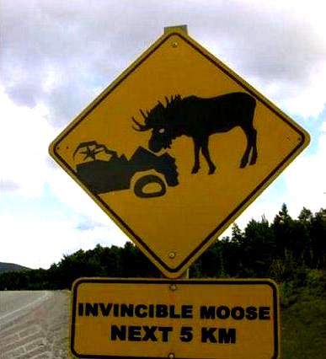
What Gets in the Way?
Collect Data on Barriers and Facilitators
(i.e., Process Measures)

Slide 13
Barriers: Ishikawa’s Fishbone Diagram
Common Categories:
Policies (the rules)
Procedures (what we actually do)
“Plant” (resources like time, money, or space)
People (skills, attitudes, comfort)
Politics (leaders, environment)

Slide 14
Facilitators: What Moves Us Forward?
An outcome measure tells you whether you are done with the project
An outcome measure should be patient-centered – it’s the big “so what”
A good outcome measure is what keeps you going when things get tough: “we’re saving lives”
A good outcome insulates you against competing priorities
A good outcome keeps you honest – it’s always your responsibility
A process measure tells you what you are actually doing
Process measures are usually provider-centered, and that’s fine
Each intervention will likely have a different process measure
You should have one big outcome, but many process measures
Drop or add process measures for each new intervention

Slide 15
If the Process Involves Training …
The Kirkpatrick typology:
1. Were providers satisfied with the training?
2. Did providers learn new knowledge, skills, or attitudes (KSAs)?
Could be a “how much did you know before vs. after,” although that’s weaker
Could be an actual test of knowledge
Could be an attitudes measure
3. Did that translate to changes in actual practice behavior?
Could be a “willingness to change” or “intention” question, although that’s weaker
Could be a “comfort with this practice” question, although that’s weaker
The best measure is what providers actually did in practice
4. Did those new behaviors make a difference in patient care?
I have been working for the AETCs since 2005 and this Practice Transformation Project is the first time that we actually get to find out!

Slide 16
Balancing Measures
Balancing measures = interventions’ “side effects”
Common balancing measures:
Valuable time consumed
Bottlenecks or slow-downs at other points
Provider annoyance or complaints
Patient dissatisfaction or complaints
Failure to do one thing while we were focused on something else
Lack of access to care because we were too focused on something else
Change fatigue
What could possibly go wrong?

Slide 17
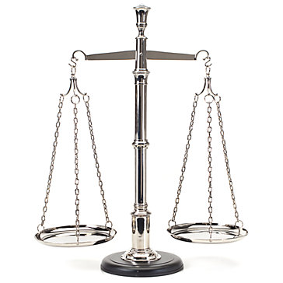
How is this Different From …
Program Evaluation?
Research?
You don’t start by designing a program to meet identified needs
Solutions are small, iterative, ad hoc
You don’t know all interventions in advance
You’re willing to “fail fast” and try something else
You shouldn’t look at summative outcomes until the end of the study
Patients don’t opt in to QI; they might not even be aware it’s going on
Solutions are based on well-known data
You don’t specify all of your procedures in advance; a change is not a “protocol deviation”
You never peek at the outcome data until the end of the study
Notes:
IRB regulations (45 CFR 46) – apply only to “human subjects research.” QI has human subjects, but is not research because it doesn’t “create generalizable knowledge.”
HIPAA privacy rule (45 CFR 160) – has a specific exemption for QI activities

Slide 18
WHERE ARE WE GOING?
Use PDSA Cycles to Track changes in Outcomes over time

Slide 19
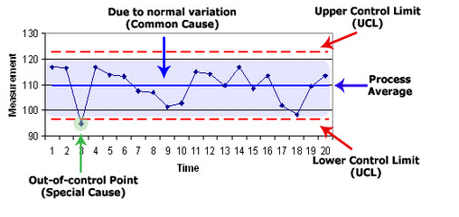
Tracking Data Over Time
Control Chart

Slide 20
The PDSA Cycle
Plan an intervention
Try it out
Set a timeframe – give it a fair test
Look at the data: process measures say what you did, outcomes say whether it worked
Did the process measure improve?
If not, try again. What would make it work better next time around? How can you overcome barriers?
Did the outcome measure improve?
If the process worked but the outcome didn’t improve, you need to try a different intervention!
Check your balancing measure
As long as there were no unintended consequences, you’re done! Congrats!

Slide 21
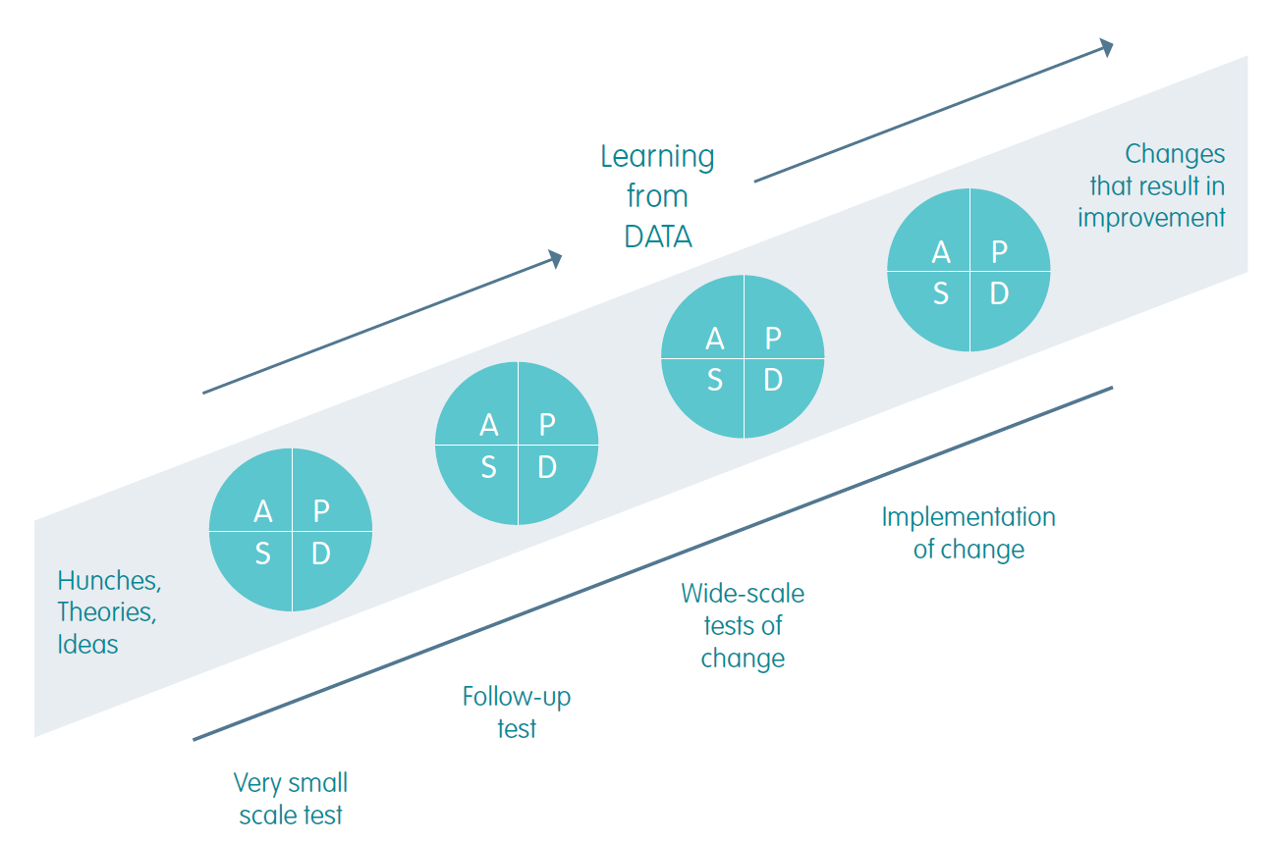
Keep Doing Those PDSAs!
Start small and build
Don’t be too attached to any single plan
Get input and feedback from everyone you can
Go where the data lead: “facts are always friendly”
Drop failed ideas
Build on successes
Keep tweaking: QI is never finished

Slide 22
WHAT’S THE RIGHT OUTCOME?
Always ask what outcome matters most to the patient; patients are the reason the health care system exists!

Slide 23
Contact Information
Paul Cook PhD
University of Colorado College of Nursing
303-724-8537
paul.cook@ucdenver.edu

